Slide 1
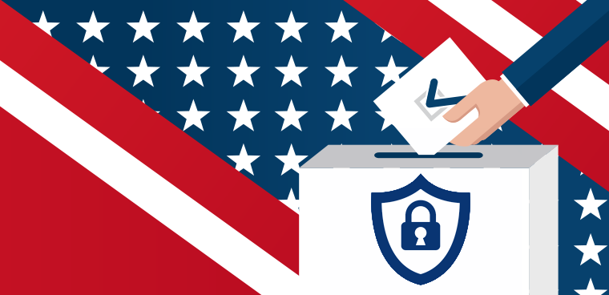
Building a Standard for Election Security
Emelin Flores & Dario Tapia

Slide 2
Table of Contents
Introductions
Project Goals/Objectives
What is a compliance standard?
The Process
The Outcome
Professional Development
Next Steps

Slide 3
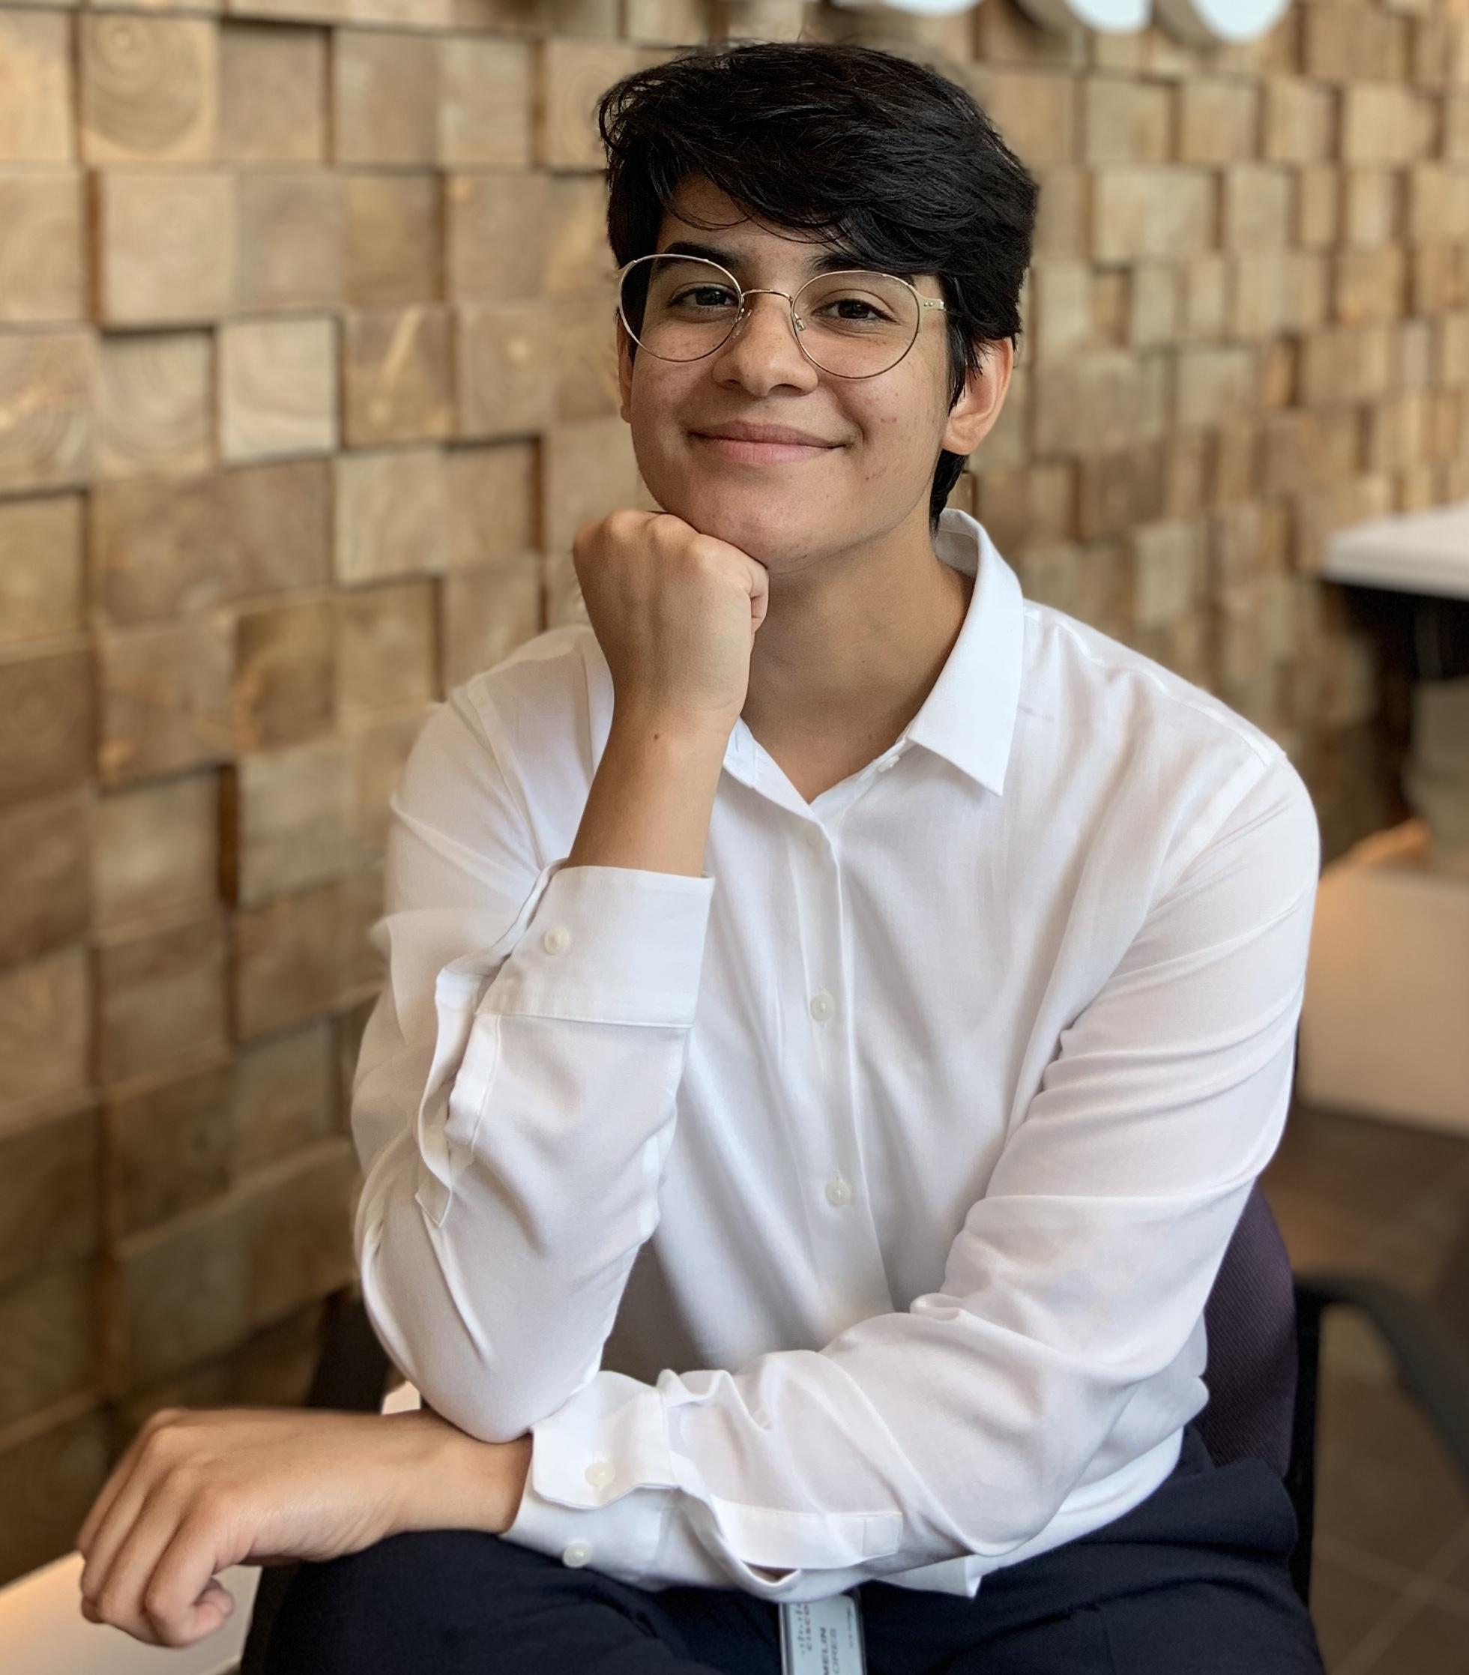
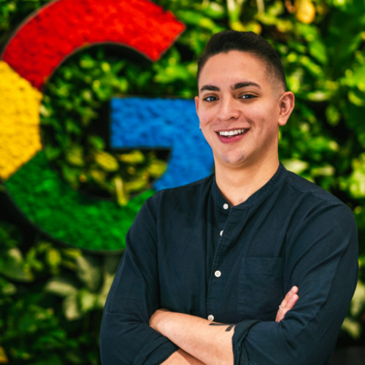
I’m Emelin!
Senior @ Rutgers fall ‘20
Looking for opportunities in cybersecurity governance or privacy policy
I’m Dario!
Program manager/Engineering Compliance @ Google
Accepted to NYU Cybersecurity Masters Program
@meatballthecorgii 13k followers

Slide 4
The Project
Learn about creating compliance standards
Develop compliance standard for election security for GSS STEM Scholar program
Present to NJ legislatures for improvements
Goals and Objectives

Slide 5
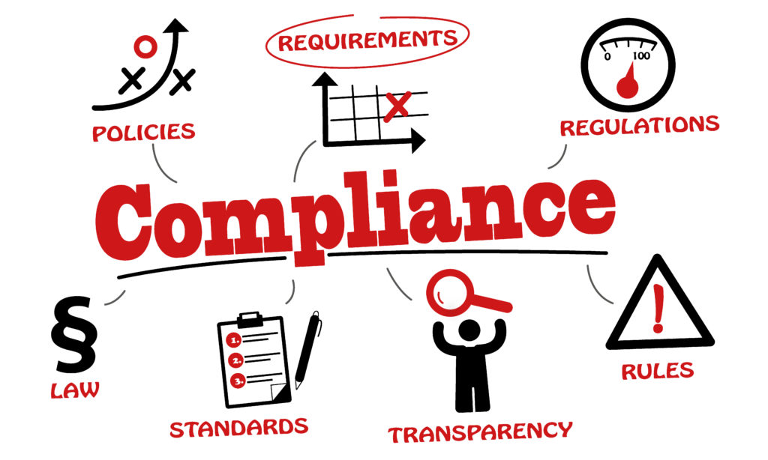

Slide 6
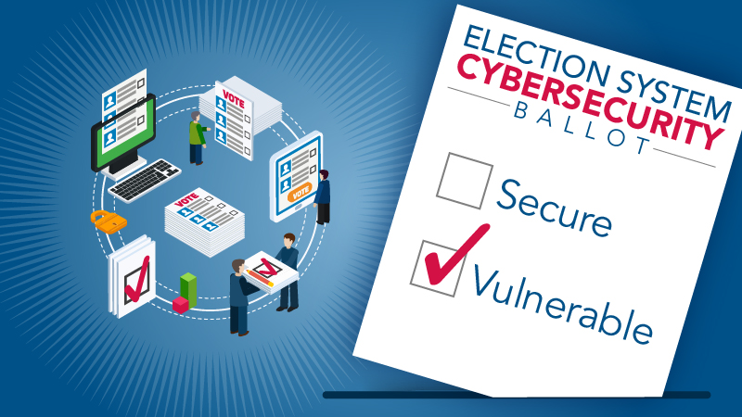

Slide 7
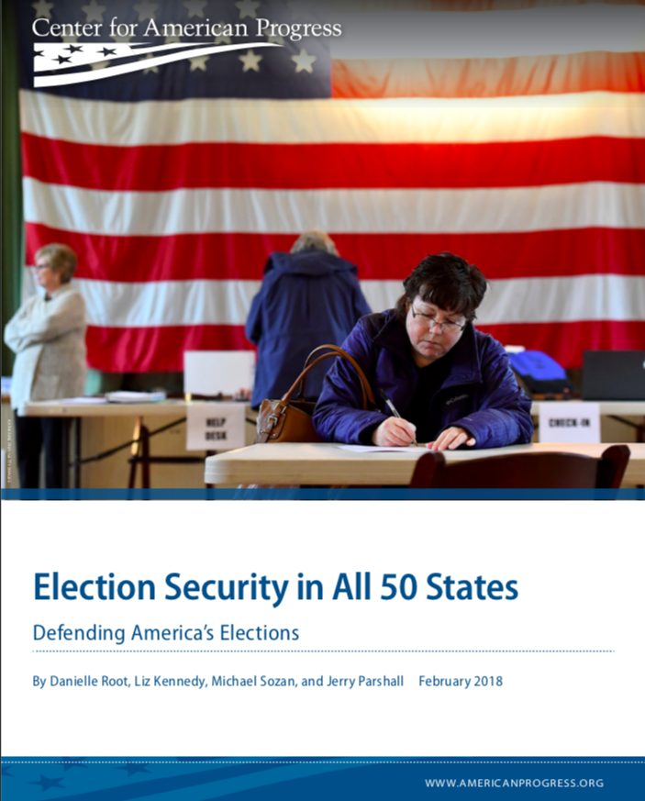
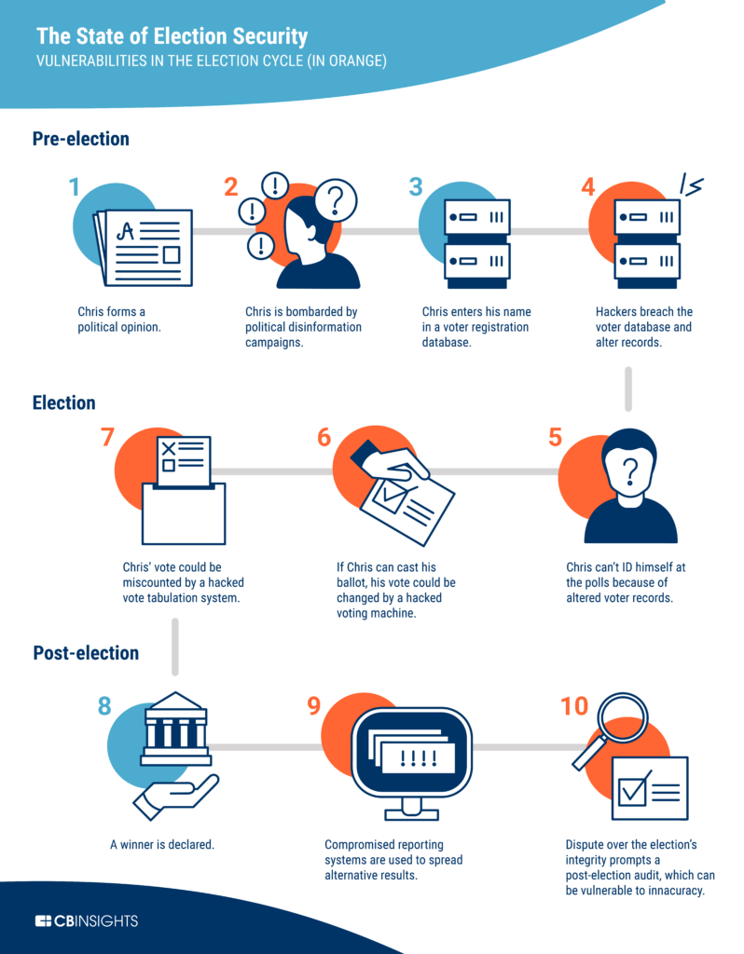
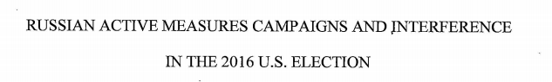
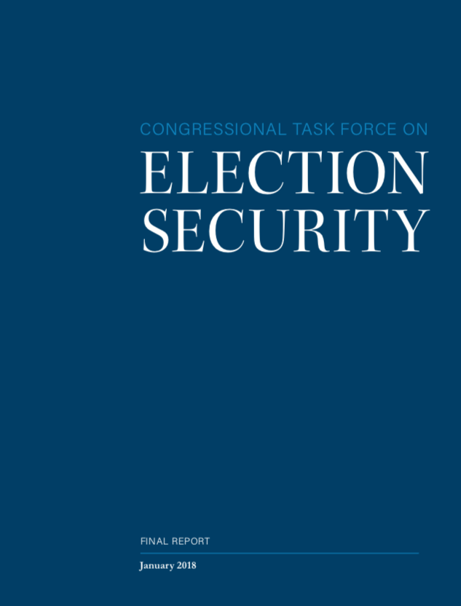
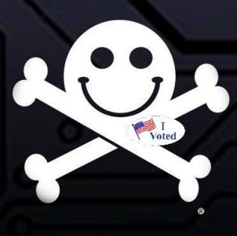
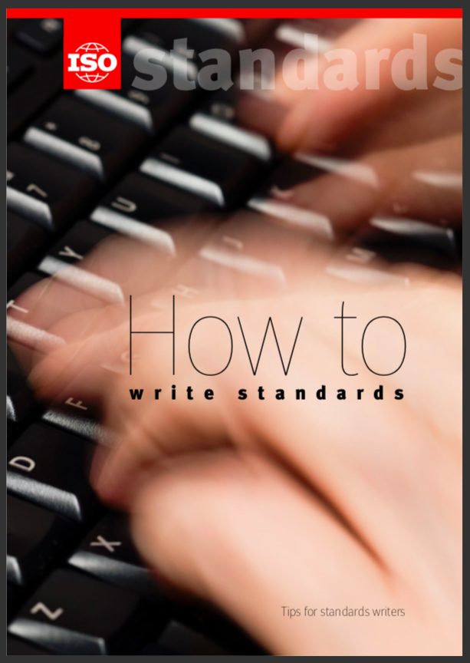

The Process

Slide 8
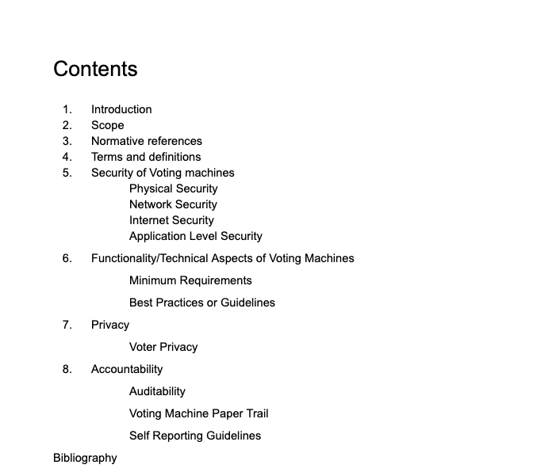
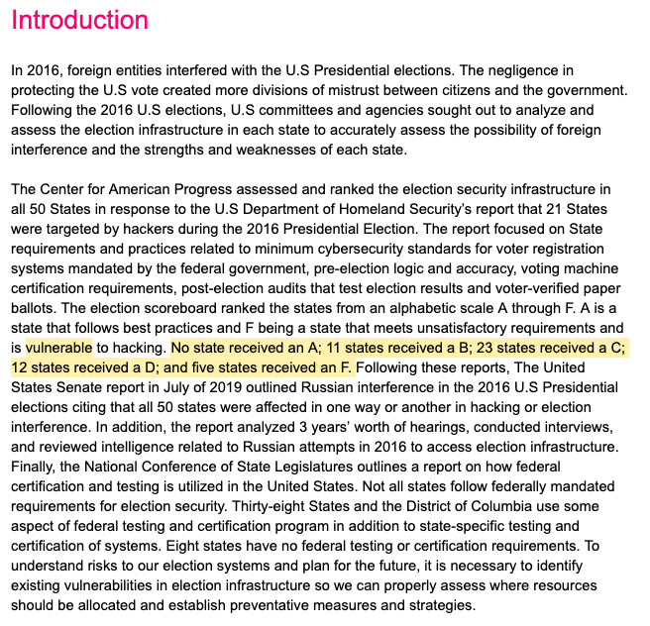
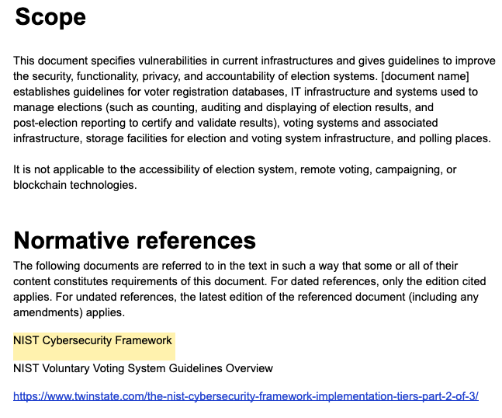
The Outcome
Produce a layout of what my standard would address
Learn about the basics of standards through ISO
Start thinking about how to approach a standard that is less technical

Slide 9
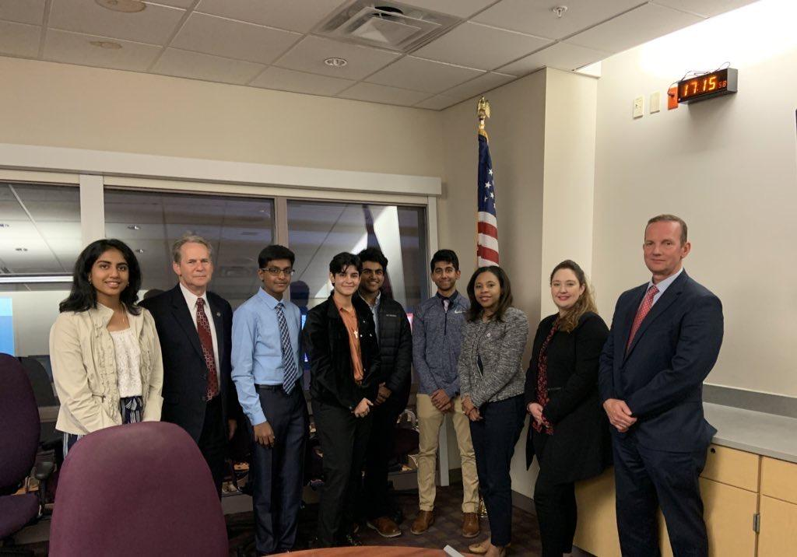

Slide 10
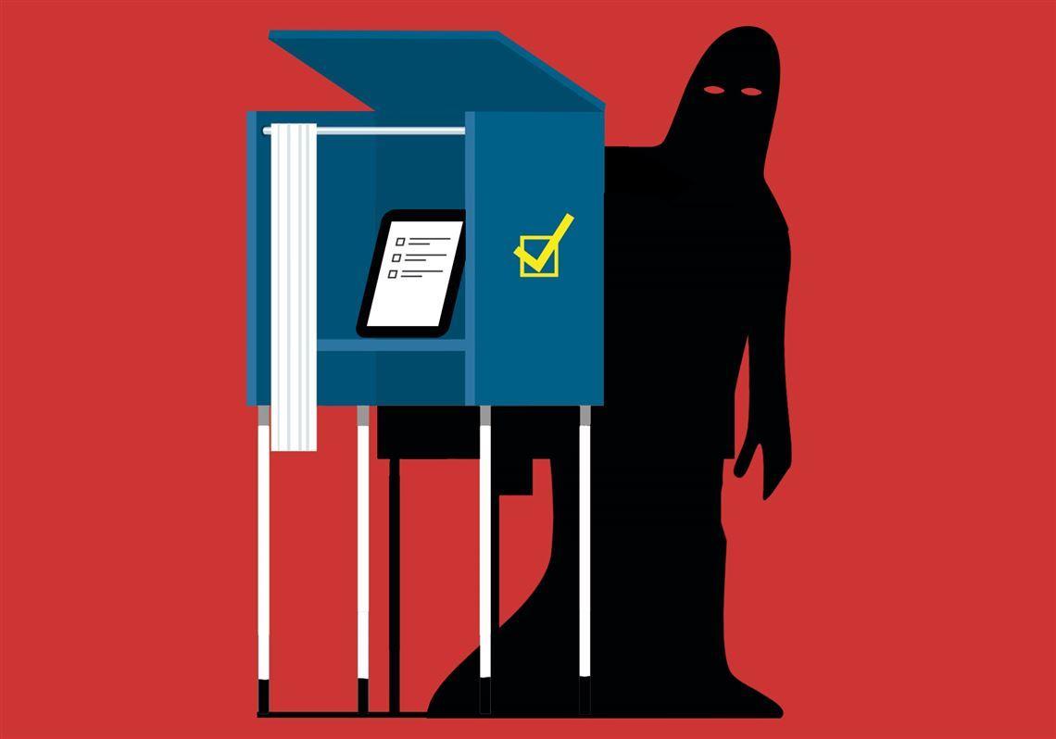
Next Steps
Continue to work on my research and develop a standard that NJ can adopt
Get into a role where I can do tech policy, cybersecurity governance
Secure the vote!

